Slide 1

POULTRY FARM MANAGEMENT SYTEM (ECHOCHICK FARM)
CMT 400: RESEARCH PROJECT FINAL PROJECT
NAME: PATRICK OGONYO OCHANYO | REG: 1036658
SUPERVISOR: CHRIS NANDASABA

Slide 2
Content
Background of the Research
Problem Statement
Main & Specific Objectives
Analysis
Design
Implementation

Slide 3
Background of the research
Research Topic: Poultry Farm Management System
Database software for efficient management of poultry farm activities
Essential for effective poultry farm operations
Background of the Research
Need for Information in Farm Decision Making
Importance of transforming data into useful, meaningful information
Integration and interconnection of data components for decision support
Farm Information System (FIS)
Tool for forward planning, risk management, and information use
Crucial for the success of poultry production enterprises

Slide 4
Problem Statement
Manual Record-Keeping Issues:
Time-consuming and unorganized
Data easily misplaced and inefficient
Difficulty in retrieving required reports
Challenges in monitoring bird health, expenses, and income
Additional Challenges:
Lack of real-time information sharing
Slow information conveyance, especially in stock level determination
Increased company costs due to inefficiencies
Inadequate data recovery in case of disasters (fire, flood, etc.)
Need for an Information System:
Proper management of poultry farm operations
Efficient data handling and real-time updates
Enhanced monitoring and reporting capabilities

Slide 5
Main & Specific Objectives
Aim of the Research
Develop a comprehensive Poultry Farm Management System (PFMS)
Streamline operations, automate processes, and improve efficiency and productivity
Specific Objectives
Establish a decentralized data model tailored for an efficient PFMS
Facilitate remote customer orders from various locations
Design and implement a system capable of generating comprehensive records encompassing all stored details

Slide 6
Requirements analysis
Functional Requirements
User Details Management:
Create, retrieve, update, and delete user information.
Product Registration and Views
Register new product details and product details.
Simple User Interface
Easy navigation for users of varying technical expertise.
Product Browsing and Ordering
Browse products, add to cart, select shipping/payment options, and place orders.
Order verification, inventory checks, payment processing, and shipping with tracking information.
Payment Integration and Authorization
Integration with payment gateways for online payment processing.

Slide 7
Non-Functional Requirements
Data Validation
Ensures all user inputs are correct and complete.
Platform Compatibility
Operates reliably across various platforms.
User Friendliness
Easy-to-use interface.
Completeness, Consistency, and Reliability
Provides all expected features and behaves consistently over time.
Security
Strong protocols to prevent unauthorized data access.
Input-Output Correctness
Accurate output for given inputs.

Slide 8
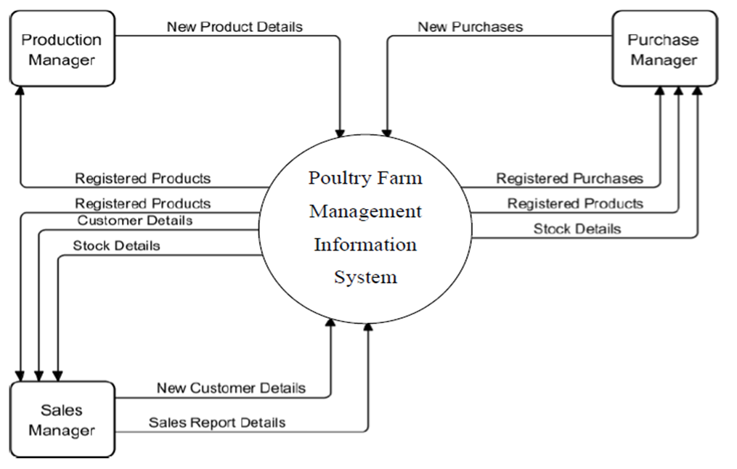
System analysis
Context Diagram

Slide 9
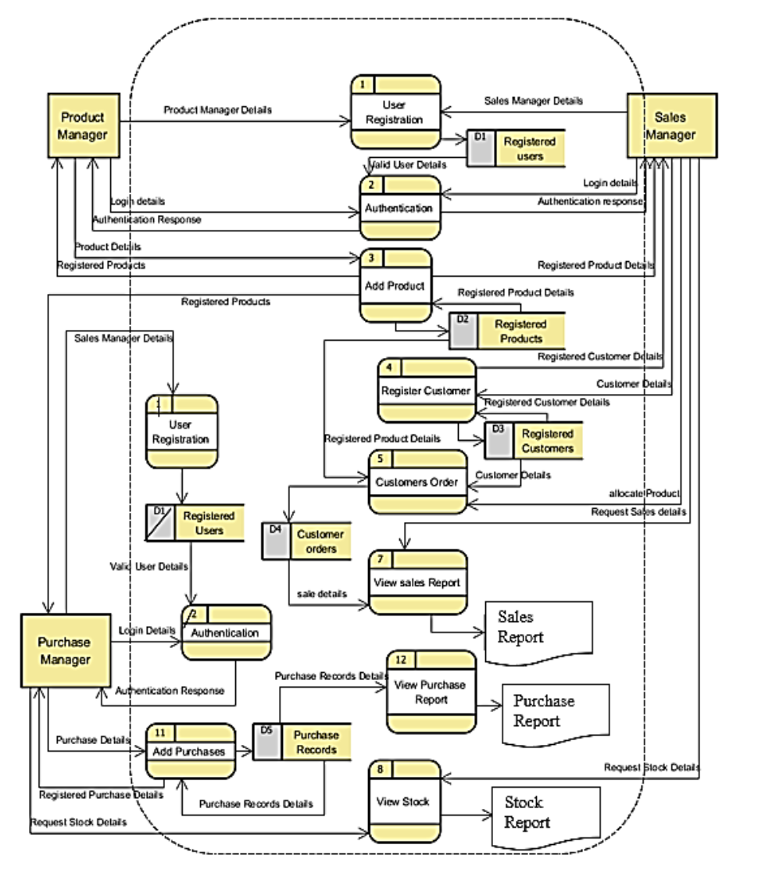
System analysis
Level 1 Data Flow Diagram

Slide 10
System Design Process design
Flowchart

Slide 11
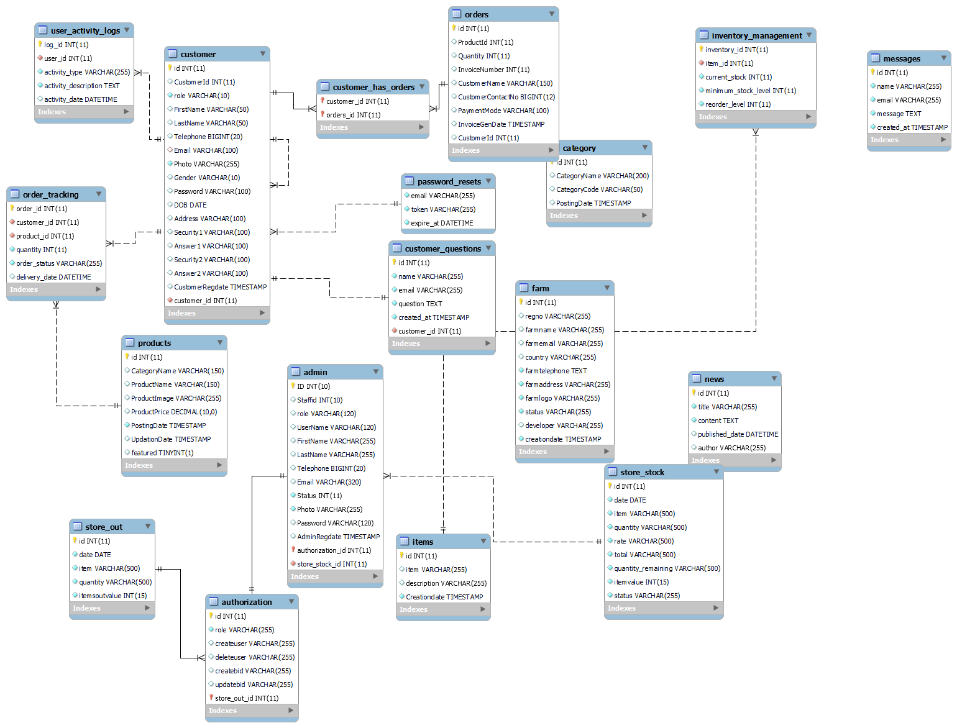
Database Design(ERD)

Slide 12
Implementation
Front-End Development
Designed user interfaces using HTML, CSS, and JavaScript.
Back-End Development
Developed server-side logic using PHP.
Implemented database with MySQL.
Database Integration
Connected front-end with back-end database for data management.
Features Implemented
User authentication and authorization.
CRUD operations for user and product data.
Product browsing, ordering, and payment processing.
Order management and tracking.
Testing and Validation
Conducted system testing for functionality and performance.
Validated accuracy and reliability of data processing.

Slide 13
The End
Thank you for your attention.
I now invite the panel to view the System of the EchoChick Farm Poultry Management System.

